Slide 1

AI-Driven Gamification Platforms in Higher Education
Enhancing Engagement through Intelligent Learning Systems
A review paper by Harith Bhuvan S, Pallapothu Hanumath Sai Krishna, Shreyas Rajesh Nair, Gorrela Tulasi Lasya, and Kashyap S.

Slide 2
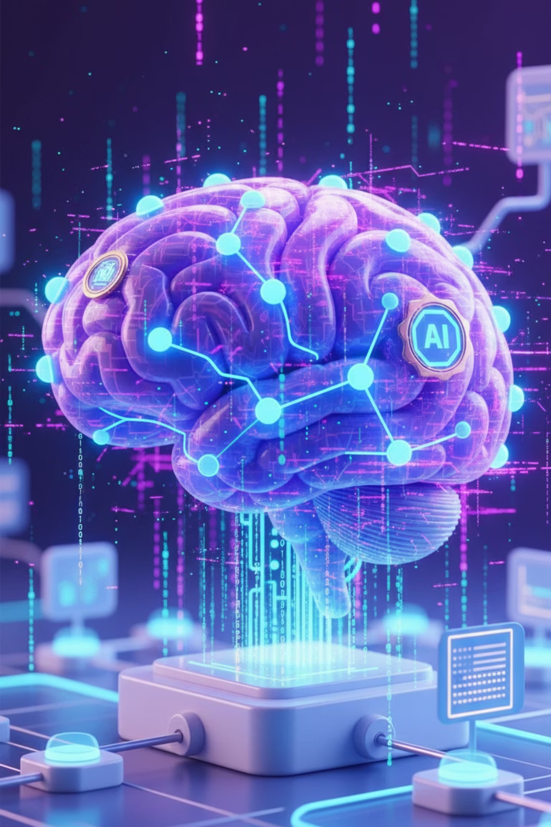
Abstract: The Power of Adaptive Learning
This study explores the effect of integrating Artificial Intelligence (AI) into gamification systems to improve learning in higher education.
Personalized Pathways
Enhanced Motivation
AI generates adaptive learning experiences by focusing on data obtained from intelligent systems.
Gamification elements like badges, rewards, quizzes, and friendly competitions boost student engagement and knowledge retention.
Effective Outcomes
Comparative analysis shows significant improvements in student motivation, collaboration, and perceived fairness in assessment.

Slide 3

The Shift from Traditional Education
Traditional higher education relied on fixed curricula, uniform assessments, and limited adaptation, often leading to low student engagement.
A New Landscape
Recent advancements in AI and gamification are dramatically reshaping this traditional pathway.
Gamification uses game elements (points, badges, challenges) to boost motivation.
AI enables adaptive, custom learning plans based on published learning sciences.
Enhanced assessment systems adapt to student performance for personalized pathways.

Slide 4



AI-Enriched Gamification Framework
We propose a framework using Edge-AI-driven educational game elements to address key challenges in digital education.
Challenge: Limited Engagement
Strategy: Edge-AI Games
Outcome: Continuous Engagement
Jeopardy-style quizzes and competitive multi-team challenges.
Uniform teaching models fail to capture student interest.
Sustains continuous engagement and a collaborative approach to learning.
This approach outlines measurable improvements in student performance, satisfaction, and motivation across different disciplines.

Slide 5



Applications of AI in Education
AI makes learning more personalized, efficient, and accessible for both students and educators.
Personalized Learning
Teacher Support
Cost Efficiency
AI tracks progress, pace, and needs in real-time, providing customized lessons, quizzes, and feedback.
AI manages administrative tasks like grading, attendance, and scheduling, freeing up teacher time.
Students save on tuition costs by accessing personalized support and resources anytime, anywhere.

Slide 6
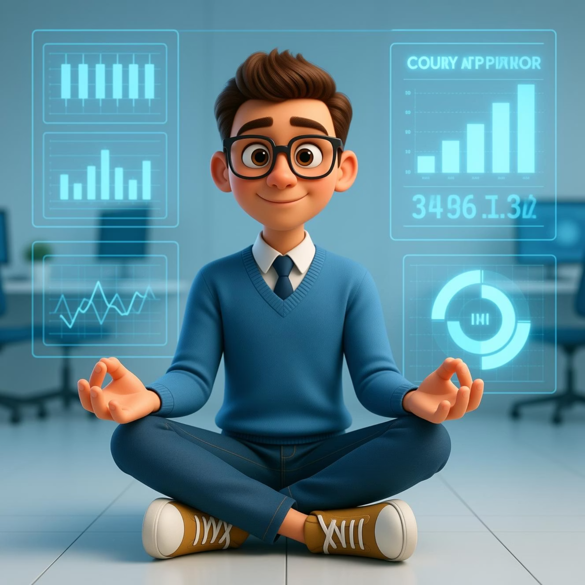

Holistic Student Support
Beyond academics, AI provides advanced solutions for
student well-being and global opportunities.
Real-Time Monitoring
AI monitors progress and engagement, detecting when students are stuck or at risk of failing, providing data-driven insights.
AI tools can measure stress levels by tracking facial expressions and behavior patterns, offering personalized relaxation techniques and suggesting professional help if necessary.
Overall, AI fosters innovation, inclusivity, and lifelong learning, paving the way for a more intelligent and adaptive global education system.

Slide 7



Motivation and Engagement in Gamified Learning
Gamification elements stimulate both intrinsic and extrinsic motivation, enhancing commitment and active participation.
Scoring & Challenges
Instant Feedback
Hybrid Classrooms
Encourage competent behavior and commitment to learning.
Allows immediate correction and reinforcement of concepts.
Creates an atmosphere encouraging active participation and collaboration.
Generative AI further enhances this by dynamically adjusting task difficulty to match the learner's skill levels, ensuring a "Learning Flow Experience."

Slide 8












The Six Dimensions of AI-Gamified Learning
The AI-enhanced gamification model is validated by six distinct, related motivational dimensions (GALEMS).
Motivational Resonance
Learning Flow Experience
Rewards and challenges fulfill the need for competence.
Enjoyment when AI balances task difficulty with skill.
Learning Self-Efficacy
Cognitive Immersion
Overall confidence in mastering academic material.
AI challenges encourage critical thinking and creativity.
Reflective Metacognition
AI-Driven Social Dynamics
Student's ability to self-regulate and adjust learning strategies.
AI assists in collaboration and knowledge-sharing.

Slide 9
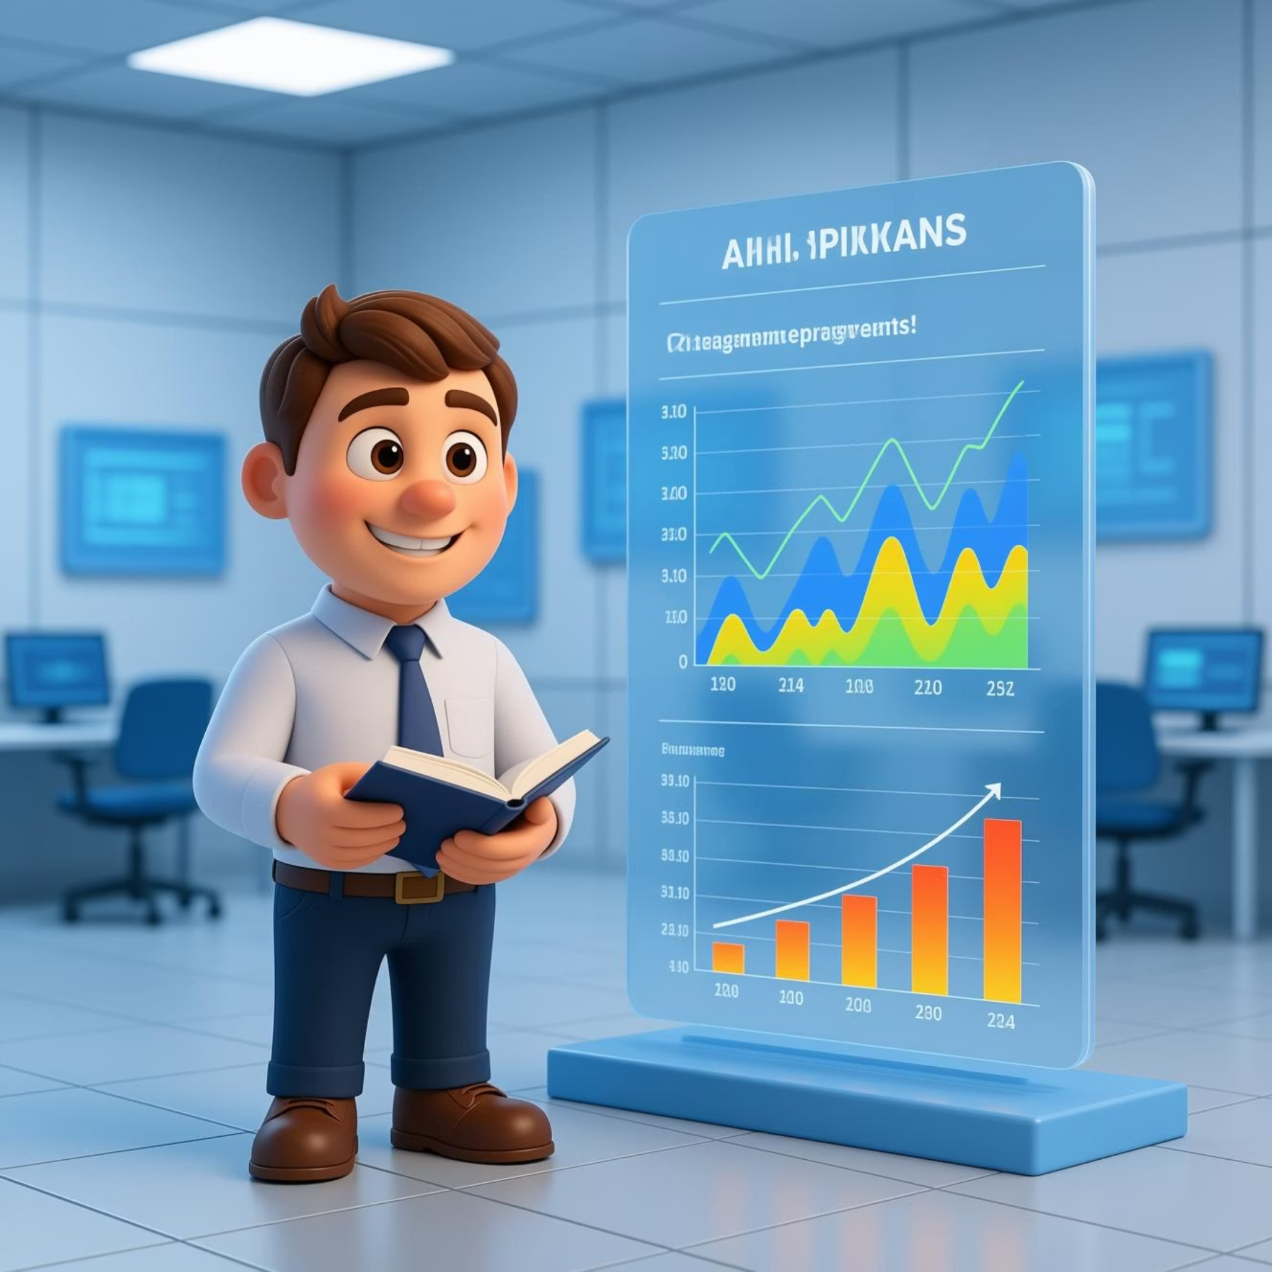
Learning Analytics and Data Processing
Intelligent systems continuously collect and analyze data from
gamified interactions to modify teaching methodology.
Data collected includes response speed, accuracy, engagement levels, and common areas of confusion.
Identify motivation spikes and drop-off points.
Adjust teaching strategies and curriculum design.
Generate richer datasets than traditional methods.
This data is used to create friendly competitions and make content easier, motivating students to be more engaged.

Slide 10
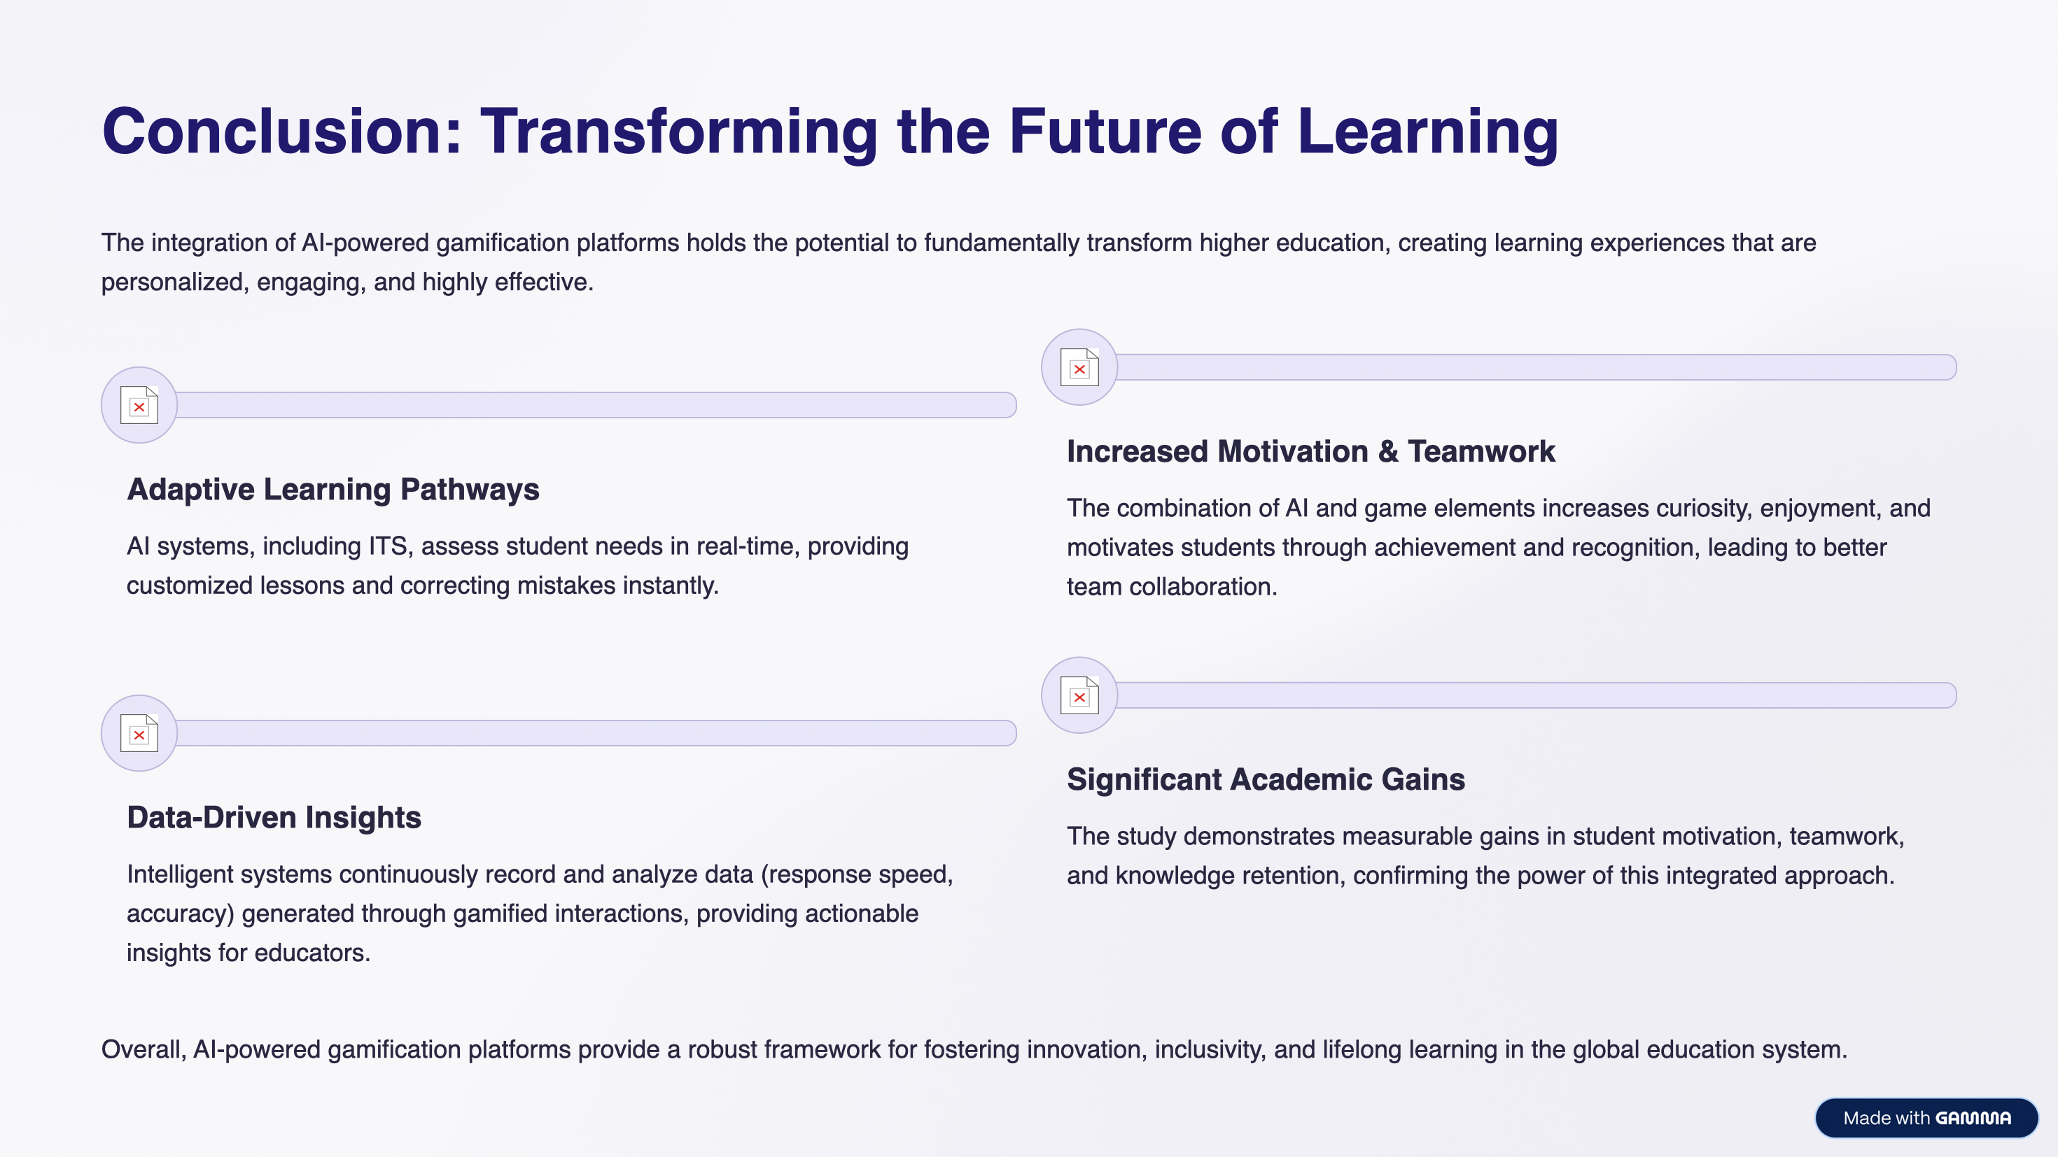
Caption
Caption

